Slide 1

Recognition for Volunteering
Jayne Golden
Volunteering Opportunities Manager

Slide 2
During this session…………….
Background to Volun-tees
Awards and Recognition
Plus Award
Recording Hours process
Award Event
New distance travelled 2026
Any questions

Slide 3
Background to Volun-tees
2003
2010
2014
2016
2021
2026
Launch of Community Volunteering Project
Community Star Awards
Volun-Cheers Awards
Plus Award
New Volun-tees Platform with Open Campus
Introduction of Distance Travelled

Slide 4
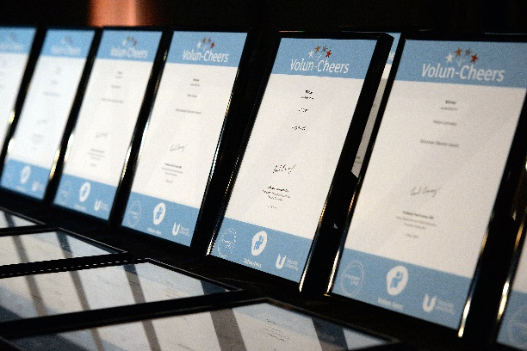
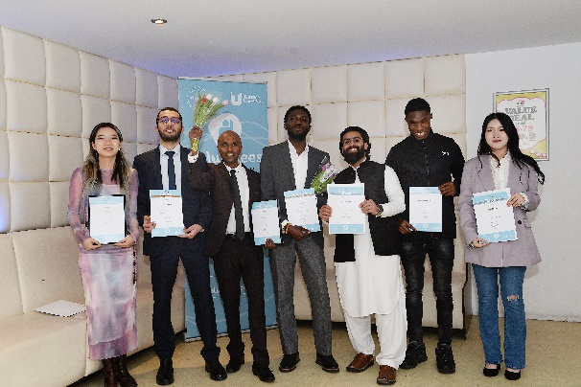
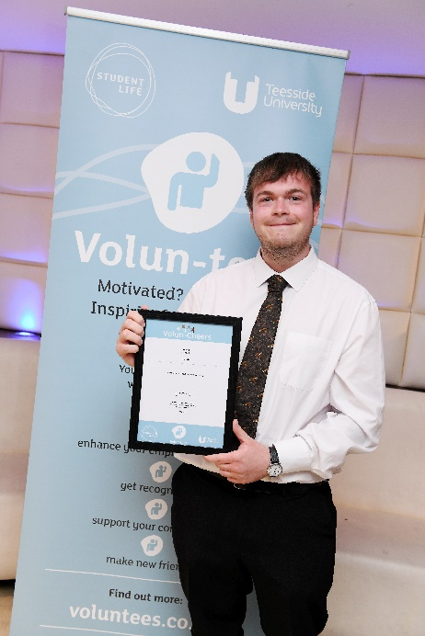

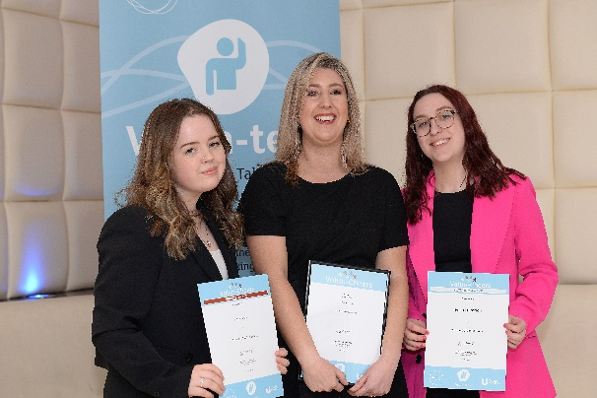
Awards and Recognition
Volun-Cheers Event – May
Bronze Award 50 hours
Silver Award 75 hours
Gold Award 100 hours
Platinum Award 250 hours
Volunteering Experience –a minimum 50 hours (achieving the Bronze Award)
+Plus award volunteering – an additional 10 hours skills based volunteering
Reflection - Review volunteering experience with a one-to-one session with a Careers Consultant.

Slide 5

Recognise skills gained through volunteering
Discuss future career aims/ambitions
Translate volunteering experience onto CVs/ applications forms
Achieve an additional award
Plus Award Process

Slide 6
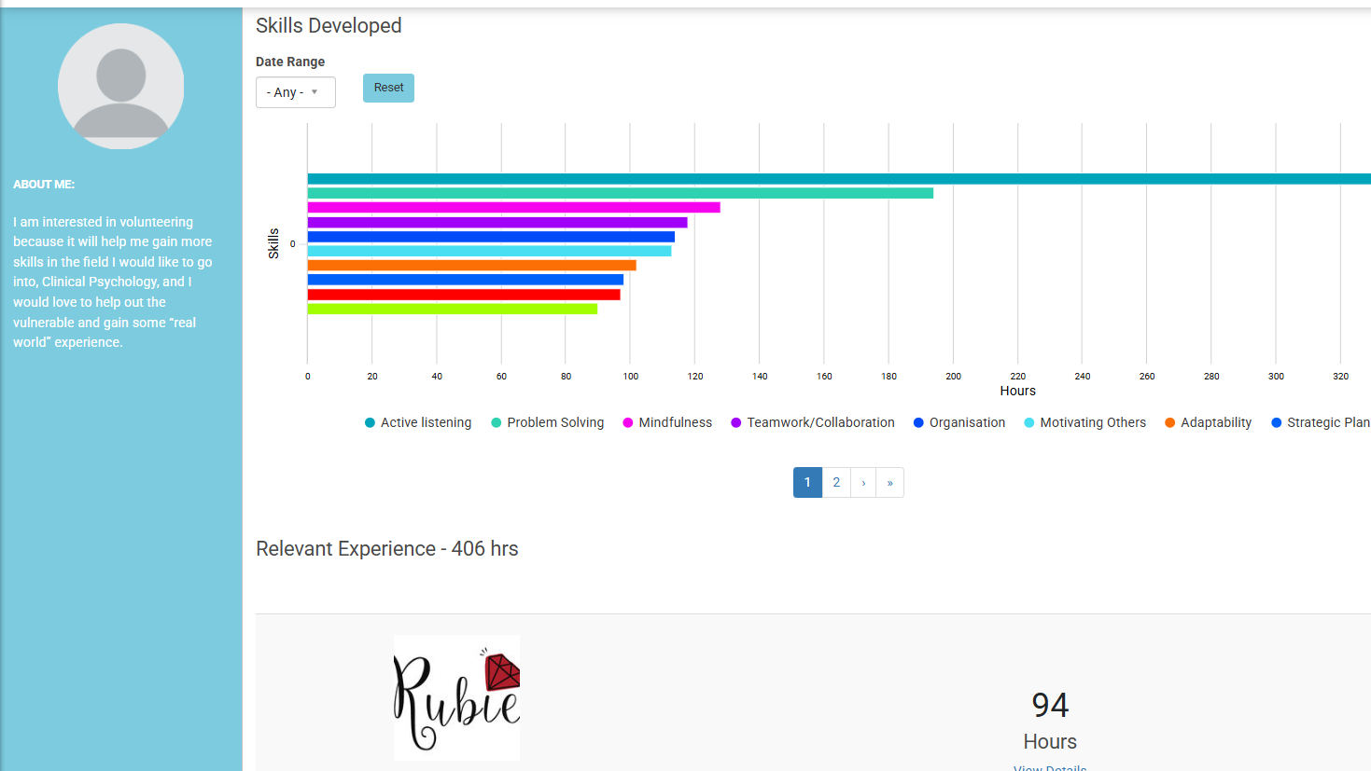
Recording hours process

Slide 7
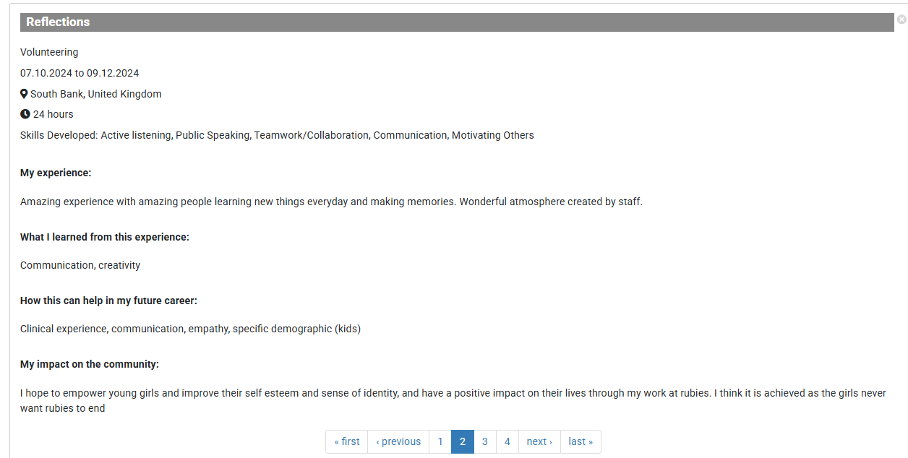

Slide 8
Recording hours process
Students must be registered on the Volun-tees platform.
Submit a log of hours, which includes:
Date, time and number of hours completed
Reflecting on the experience and also providing feedback on opportunity
Hours are then validated and verified by Opportunity provider with the option to include an endorsement.

Slide 9
Awards Event
Event – 8th May 6.00 – 9.00 pm
Based in the Students’ Union
11,500 hours recorded
81 Certificates achieved
150 guests attending
11 Additional Volunteering Awards
LinkedIN Award badges produced

Slide 10
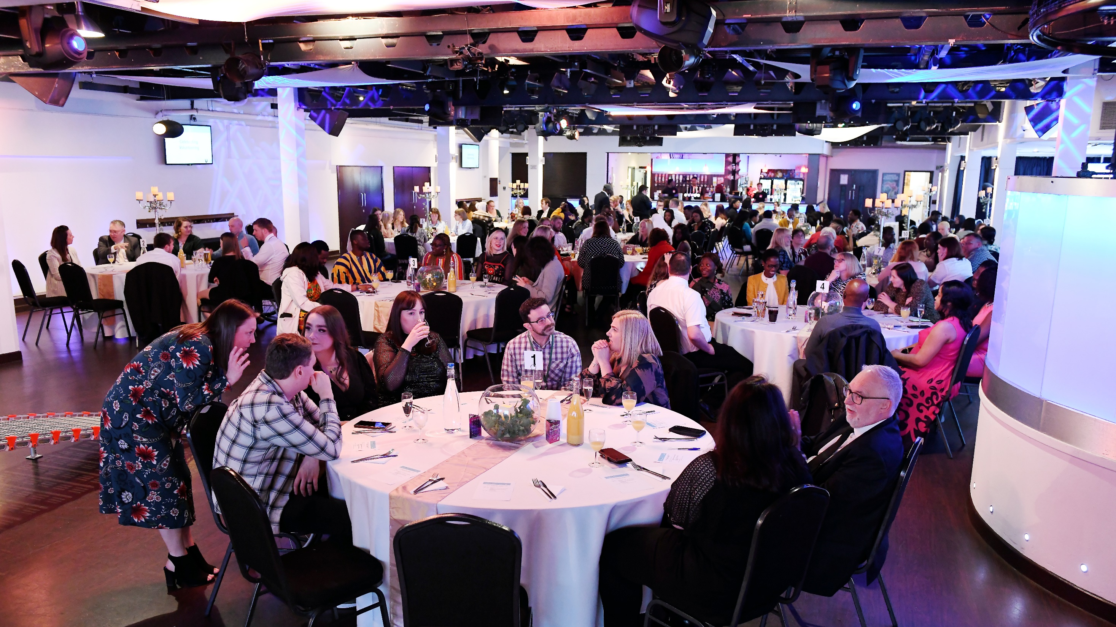
Volunteering Awards
  Community Shining Star
  Unsung Hero
  Making a Difference
  Community Impact
  Inspiring Volunteer
  Outstanding Contribution to the University
  Special Recognition
  Exceptional Mentor
  Volunteering Organisation
  Transforming Lives
  Volunteer of the Year

Slide 11

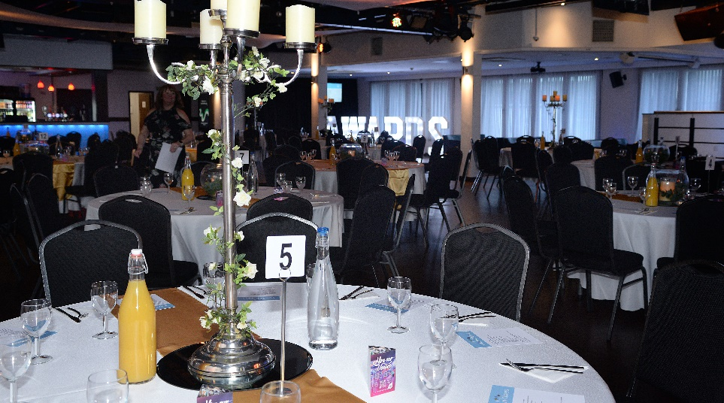
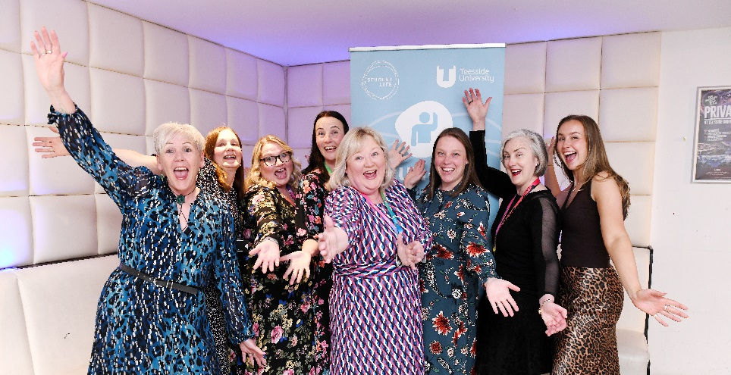
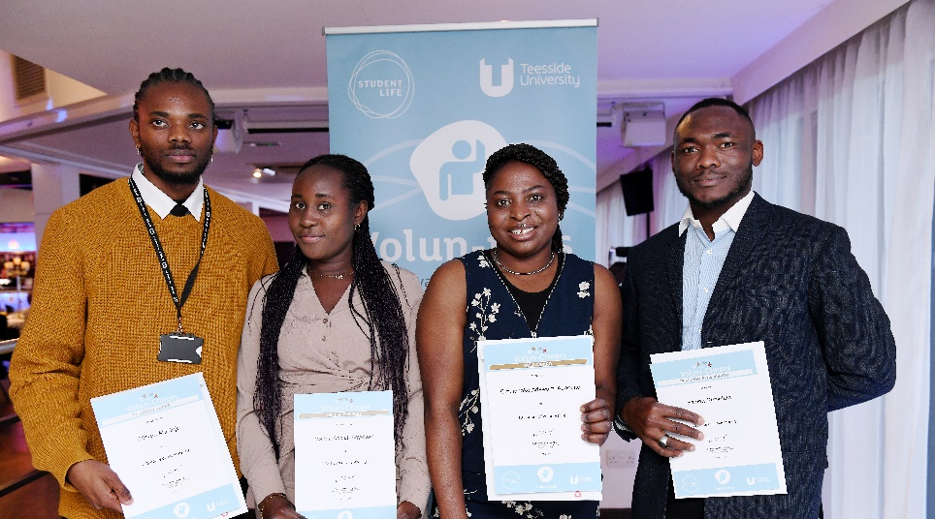

Slide 12
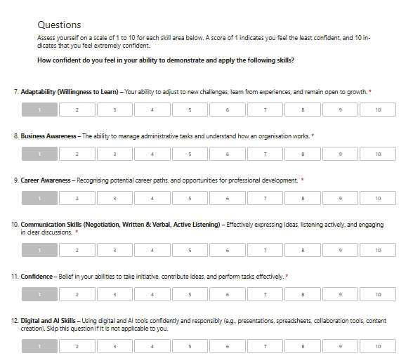
New distanced travelled process

Slide 13
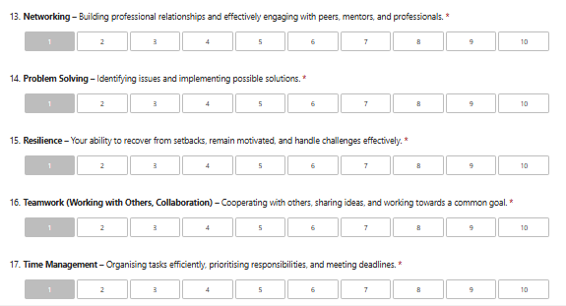
New distanced travelled process

Slide 14
Any Questions……?
Voluntees.co.uk
j.golden@tees.ac.uk

